Slide 1
AI CHATBOT FOR DEPARTMENT OF TECHNICAL EDUCATION
By Lahari Machetti
21VV1A1240

Slide 2
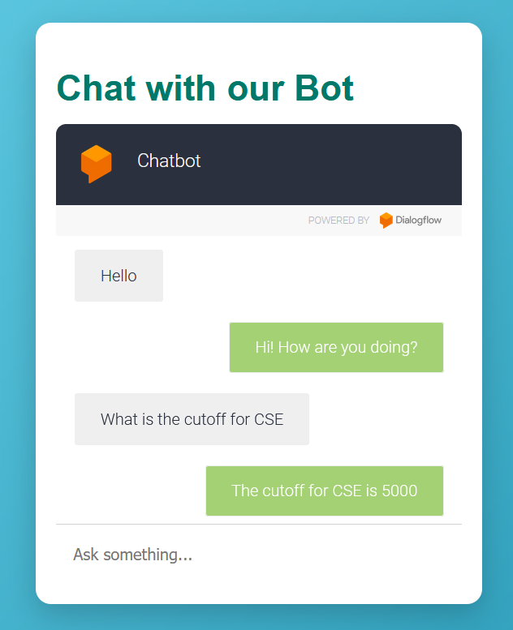
INTRODUCTION
This chatbot provides users with predictions on cutoff ranks for different academic branches based on their rank and caste category. By inputting rank information, users can quickly see which branches might be available to them, helping to simplify the admissions process and set expectations regarding their eligibility in various departments.

Slide 3



OVERVIEW
The project involves building a user-friendly chatbot interface for college admissions using HTML, CSS, and Dialogflow. The webpage features a sleek design with a gradient background, a centrally aligned chatbot container, and smooth animations for an interactive experience. CSS animations like a glowing border effect and slide-in transitions enhance visual appeal.
The embedded chatbot, integrated via an iframe, connects to Dialogflow and allows real-time responses to common inquiries.

Slide 4
DIALOGFLOW
1. Create a Google Cloud Project
Go to the Google Cloud Console: https://console.cloud.google.com
Sign in: Use your Google account to sign in.
Create a new project:
Click the project dropdown at the top of the page.
Select "New Project."
Name the project and click "Create."
2. Enable Dialogflow API
Search for "Dialogflow" in the Google Cloud Console.
Select Dialogflow API and click Enable.

Slide 5
3. Go to Dialogflow Console
Visit the Dialogflow Console: https://dialogflow.cloud.google.com.
Sign in with your Google account if prompted
4. Create a New Agent
On the left menu, click "Create Agent."
Fill in the required details:
Agent Name: Give your agent a name (e.g., "ChatBot").
Default Language: Select the default language (e.g., English).
Google Project: Select the Google Cloud project you created earlier.

Slide 6
5. Create Intents
Intents define how the bot understands and responds to user queries.
Go to Intents on the left panel.
Click "Create Intent."
Name the intent (e.g., "Get College Info").
Add Training Phrases: Provide example user queries like "What is the cutoff for CSE?" or "How many seats are available in IT?"
Responses: Add responses for the agent to provide when the intent is matched (e.g., "The CSE cutoff is X rank.").
Click Save when done.

Slide 7
6. Enable Web Demo:
Navigate to the Integrations section on the left panel of the Dialogflow console.
Enable the Web Demo option.
You will be provided with an embed link (iframe code) that can be used to display the chatbot on any webpage.
7. Embedding the Chatbot into HTML
Once your Dialogflow agent is ready, you can embed it into a webpage using the HTML iframe element. This allows the chatbot to appear directly on the site and handle interactions with users.

Slide 8
KEY FEATURES
I have collected real-time datasets from the 2023 batch for various engineering branches, including IT, CSE, EEE, ECE, Mechanical, Civil, and Metallurgy.
The sizes of the datasets for each branch:
IT: (64, 10)
CSE: (63, 10)
EEE: (63, 10)
ECE: (65, 10)
Mechanical: (64, 10)
Civil: (31, 10)
Metallurgy: (25, 10)

Slide 9
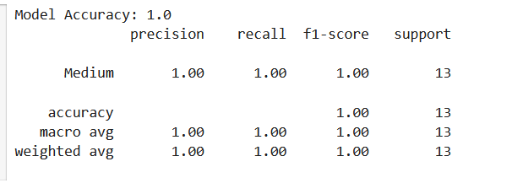
I used the Random Forest Classifier model for my project due to its powerful ensemble learning capabilities. This model combines multiple decision trees, which helps improve prediction accuracy and robustness by reducing the risk of overfitting associated with individual trees.
ACCURACY

Slide 10
Later I have styled the html page in more dynamic way by adding the below features
Background: A full-screen background image is used for visual appeal.
Typography: The heading is large and white for contrast, with a fade-in effect for smooth entrance.
Chatbot Container: The chatbot is in a semi-transparent white box with rounded corners and a shadow for depth. It has a border with a gradient color.
Positioning: The container is slightly moved to the right for better placement.
Animations: Both the heading and container have animations for a polished appearance.

Slide 11
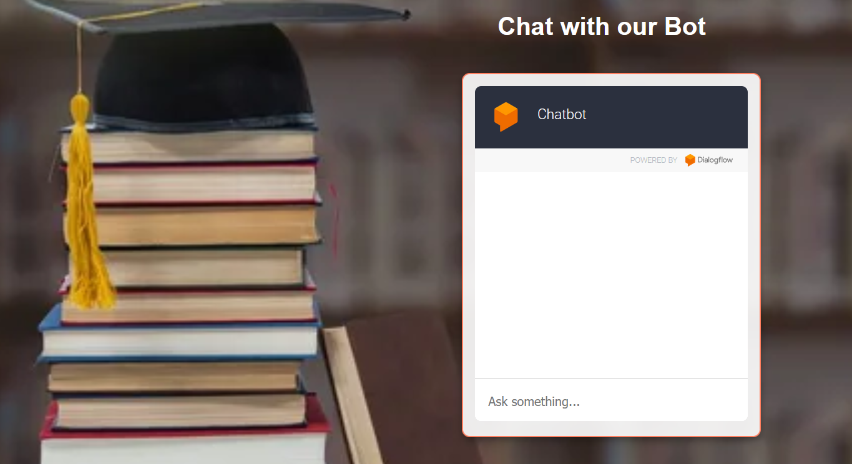
VIEW PAGE OF AI CHATBOT

Slide 12
THANK YOU

